Slide 1

SQL
Gerry Guinane
Limerick Institute of Technology
Topic 3 SQL Lecture 06

Slide 2
Transactions
When a program/application accesses a DB to effect some changes – these changes are called a TRANSACTION
A transaction is a logical unit of work
Transfer of €400 from Smith’s account to Jones account involves the following database changes in a single transaction:
Check Smith account for sufficient funds for €400 transfer
Debit €400 from Smith
Credit €400 to Jones
Apply Transaction charge to Smith

Slide 3
4 ACID Properties of Transactions
Atomicity
Durability
Consistency
Independence

Slide 4
Atomicity
The all or nothing property
A transaction is an indivisible unit of work
It should only be completely committed or not at all.
Example – in the funds transfer from Smith to Jones – all parts of the transaction must be completed or none at all.

Slide 5
Durability
Transactions are guaranteed to be durable
Once the transaction successfully executes to COMMIT – its updates are guaranteed to be applied to the database – even if the system subsequently fails.
This property is what makes a database persistent.
Example – Smith/Jones funds transfer – the full effects of the transaction are permanently written to secondary (permanent) data storage.

Slide 6
Consistency
Transactions transform a database from one consistent state to another consistent state.
A DB is said to be consistent if it accurately reflects a viable state in the mini-world being modelled.
In the funds transfer example – the DB would be in an inconsistent state if it partly executed.

Slide 7
Independence
Transactions execute independently (or in isolation) of one another.
This means that partial effects of incomplete transactions are not visible to other transactions.
COMMIT – causes the effects of a transaction to be visible to other transactions.

Slide 8
MySQL support for transactions
InnoDB is a storage engine for MySQL.
MySQL 5.5 and later use it by default. It provides the standard ACID-compliant transaction features, along with foreign key support (Declarative Referential Integrity).
Normally when a table is created it will use the default storage engine.
The SQL – ‘show engines;’ command can be used to view the default storage engine and others supported by the instance of mySQL

Slide 9
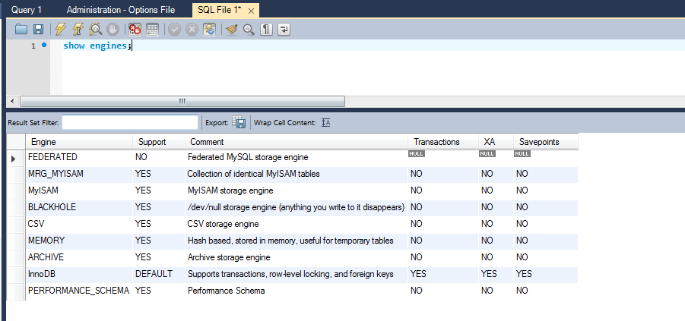
Default Storage Engine

Slide 10
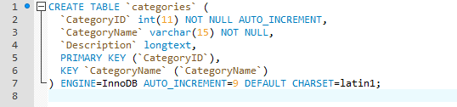
Check individual tables are InnoDB
In workbench – point to a table –> right click –> send to SQL editor – >create table

Slide 11
Autocommit
In InnoDB, all user activity occurs inside a transaction.
If autocommit mode is enabled, each SQL statement forms a single transaction on its own.
By default, MySQL starts the session for each new connection with autocommit enabled, so MySQL does a commit after each SQL statement if that statement did not return an error
A COMMIT means that the changes made in the current transaction are made permanent and become visible to other sessions
A BEGIN TRANSACTION implicitly sets autocommit to OFF until the COMMIT keyword is reached
Use ‘show variables;’ to see server variables

Slide 12
Transaction Syntax
START TRANSACTION
BEGIN
……..SQL STATEMENTS……
COMMIT ..makes transaction visible to other users/sessions
ROLLBACK …reverses the current transaction..

Slide 13
To create a stored procedure transaction
See notes page for database script
Select Schema->Stored Procedures. Right click Add Procedure
Notes:
CREATE DATABASE IF NOT EXISTS `k00999999_bank` /*!40100 DEFAULT CHARACTER SET latin1 */;
USE `k00999999_bank`;
-- MySQL dump 10.13 Distrib 5.6.24, for Win32 (x86)
--
-- Host: 127.0.0.1 Database: k00999999_bank
-- ------------------------------------------------------
-- Server version 5.5.32
/*!40101 SET @OLD_CHARACTER_SET_CLIENT=@@CHARACTER_SET_CLIENT */;
/*!40101 SET @OLD_CHARACTER_SET_RESULTS=@@CHARACTER_SET_RESULTS */;
/*!40101 SET @OLD_COLLATION_CONNECTION=@@COLLATION_CONNECTION */;
/*!40101 SET NAMES utf8 */;
/*!40103 SET @OLD_TIME_ZONE=@@TIME_ZONE */;
/*!40103 SET TIME_ZONE='+00:00' */;
/*!40014 SET @OLD_UNIQUE_CHECKS=@@UNIQUE_CHECKS, UNIQUE_CHECKS=0 */;
/*!40014 SET @OLD_FOREIGN_KEY_CHECKS=@@FOREIGN_KEY_CHECKS, FOREIGN_KEY_CHECKS=0 */;
/*!40101 SET @OLD_SQL_MODE=@@SQL_MODE, SQL_MODE='NO_AUTO_VALUE_ON_ZERO' */;
/*!40111 SET @OLD_SQL_NOTES=@@SQL_NOTES, SQL_NOTES=0 */;
--
-- Table structure for table `account`
--
DROP TABLE IF EXISTS `account`;
/*!40101 SET @saved_cs_client = @@character_set_client */;
/*!40101 SET character_set_client = utf8 */;
CREATE TABLE `account` (
`account_nr` int(11) NOT NULL,
`balance` varchar(45) DEFAULT NULL,
`branch_branch_id` int(11) NOT NULL,
PRIMARY KEY (`account_nr`),
KEY `fk_account_branch1_idx` (`branch_branch_id`),
CONSTRAINT `fk_account_branch1` FOREIGN KEY (`branch_branch_id`) REFERENCES `branch` (`branch_id`) ON DELETE NO ACTION ON UPDATE NO ACTION
) ENGINE=InnoDB DEFAULT CHARSET=utf8;
/*!40101 SET character_set_client = @saved_cs_client */;
--
-- Dumping data for table `account`
--
LOCK TABLES `account` WRITE;
/*!40000 ALTER TABLE `account` DISABLE KEYS */;
INSERT INTO `account` VALUES (25785811,'900',99),(88745874,'98',99);
/*!40000 ALTER TABLE `account` ENABLE KEYS */;
UNLOCK TABLES;
--
-- Table structure for table `account_has_customer`
--
DROP TABLE IF EXISTS `account_has_customer`;
/*!40101 SET @saved_cs_client = @@character_set_client */;
/*!40101 SET character_set_client = utf8 */;
CREATE TABLE `account_has_customer` (
`account_account_nr` int(11) NOT NULL,
`customer_customer_id` int(11) NOT NULL,
PRIMARY KEY (`account_account_nr`,`customer_customer_id`),
KEY `fk_account_has_customer_customer1_idx` (`customer_customer_id`),
KEY `fk_account_has_customer_account_idx` (`account_account_nr`),
CONSTRAINT `fk_account_has_customer_account` FOREIGN KEY (`account_account_nr`) REFERENCES `account` (`account_nr`) ON DELETE NO ACTION ON UPDATE NO ACTION,
CONSTRAINT `fk_account_has_customer_customer1` FOREIGN KEY (`customer_customer_id`) REFERENCES `customer` (`customer_id`) ON DELETE NO ACTION ON UPDATE NO ACTION
) ENGINE=InnoDB DEFAULT CHARSET=utf8;
/*!40101 SET character_set_client = @saved_cs_client */;
--
-- Dumping data for table `account_has_customer`
--
LOCK TABLES `account_has_customer` WRITE;
/*!40000 ALTER TABLE `account_has_customer` DISABLE KEYS */;
INSERT INTO `account_has_customer` VALUES (25785811,24587458),(88745874,89574584);
/*!40000 ALTER TABLE `account_has_customer` ENABLE KEYS */;
UNLOCK TABLES;
--
-- Table structure for table `branch`
--
DROP TABLE IF EXISTS `branch`;
/*!40101 SET @saved_cs_client = @@character_set_client */;
/*!40101 SET character_set_client = utf8 */;
CREATE TABLE `branch` (
`branch_id` int(11) NOT NULL,
`address` varchar(45) DEFAULT NULL,
PRIMARY KEY (`branch_id`)
) ENGINE=InnoDB DEFAULT CHARSET=utf8;
/*!40101 SET character_set_client = @saved_cs_client */;
--
-- Dumping data for table `branch`
--
LOCK TABLES `branch` WRITE;
/*!40000 ALTER TABLE `branch` DISABLE KEYS */;
INSERT INTO `branch` VALUES (99,'Limerick');
/*!40000 ALTER TABLE `branch` ENABLE KEYS */;
UNLOCK TABLES;
--
-- Table structure for table `customer`
--
DROP TABLE IF EXISTS `customer`;
/*!40101 SET @saved_cs_client = @@character_set_client */;
/*!40101 SET character_set_client = utf8 */;
CREATE TABLE `customer` (
`customer_id` int(11) NOT NULL,
`customer_firstname` varchar(45) DEFAULT NULL,
`customer_lastname` varchar(45) DEFAULT NULL,
PRIMARY KEY (`customer_id`)
) ENGINE=InnoDB DEFAULT CHARSET=utf8;
/*!40101 SET character_set_client = @saved_cs_client */;
--
-- Dumping data for table `customer`
--
LOCK TABLES `customer` WRITE;
/*!40000 ALTER TABLE `customer` DISABLE KEYS */;
INSERT INTO `customer` VALUES (24587458,'John','Smith'),(89574584,'Peter','Jones');
/*!40000 ALTER TABLE `customer` ENABLE KEYS */;
UNLOCK TABLES;
/*!40103 SET TIME_ZONE=@OLD_TIME_ZONE */;
/*!40101 SET SQL_MODE=@OLD_SQL_MODE */;
/*!40014 SET FOREIGN_KEY_CHECKS=@OLD_FOREIGN_KEY_CHECKS */;
/*!40014 SET UNIQUE_CHECKS=@OLD_UNIQUE_CHECKS */;
/*!40101 SET CHARACTER_SET_CLIENT=@OLD_CHARACTER_SET_CLIENT */;
/*!40101 SET CHARACTER_SET_RESULTS=@OLD_CHARACTER_SET_RESULTS */;
/*!40101 SET COLLATION_CONNECTION=@OLD_COLLATION_CONNECTION */;
/*!40111 SET SQL_NOTES=@OLD_SQL_NOTES */;
-- Dump completed on 2016-11-07 11:55:54

Slide 14
Example – Bank Account Funds Withdraw
Transaction code
CREATE PROCEDURE `sp_withdraw_funds`(IN acFrom INT(11), IN amount DECIMAL(8,2), OUT result TEXT)
BEGIN
DECLARE resultString TEXT;
DECLARE balFrom INT(11);
START TRANSACTION;
SET resultString='Transaction Result:';
#withdraw funds
UPDATE account
SET balance=(balance-amount)
WHERE account_nr = acFrom;
#check balance and ROLLBACK if less than 0
SELECT balance
INTO balFrom
FROM account
WHERE account_nr = acFrom;
IF (balFrom<0)
THEN
ROLLBACK;
SET resultString=CONCAT(' ** ',resultString,'***ROLLBACK: INSUFFICIENT FUNDS**');
ELSE
COMMIT;
SET resultString=CONCAT(' ** ',resultString,'***FUNDS WITHDRAWN**');
END IF;
SET result=resultString;
END

Slide 15
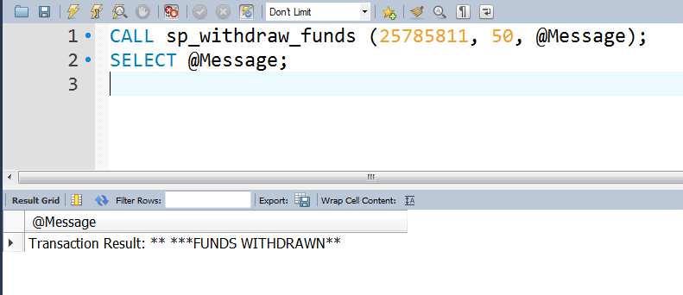
Call the stored procedure transaction
CALL sp_withdraw_funds (25785811, 50, @Message);
SELECT @Message;

Slide 16
Transaction Exercise
Create a procedure that transfers funds between two accounts with the following signature:
`sp_funds_transfer`(IN acFrom INT(11), IN acTo INT(11), IN amount DECIMAL(8,2), OUT result TEXT)
A transaction charge of 25 cents applies for all transactions
The procedure should verify that accounts from and to are valid account numbers.
Accounts cannot be overdrawn at the end of the funds transfer
If there are insufficient funds the transaction is cancelled and a further referral charge of 1.50 is levied on the FROM account

